Slide 1
TAGGING PROCESS FOR CATWALKS PICTURES – FOR JINGJING V5 24/03/2020
Final dictionary to TAG
and ADD category (L1) and subcategory (L2)
>>> to add category >>> ask Jingjing how to process

Slide 2
L0 and L1 final dictionary – 24/03/2020
L0
COLOR
FABRIC
PRINT
PRODUCT
L1
L1_Category | L1_Category text
1 | BEIGE 1
2 | BLACK 2
3 | BLUE 3
4 | BROWN 4
5 | COLOR BLOCK 5
6 | DENIM BLUE 6
7 | GOLD 7
8 | GREEN 8
9 | GREY 9
10 | KHAKI 10
11 | MULTICO 11
12 | ORANGE 12
13 | PINK 13
14 | PURPLE 14
15 | RED 15
16 | SILVER 16
17 | TURQUOISE 17
18 | WHITE 18
19 | YELLOW 19
20 | BOLD COLORS 20
21 | DARK COLORS 21
22 | INTENSE COLORS 22
23 | LIGHT COLORS 23
24 | MEDIUM COLORS 24
25 | NEUTRAL COLORS 25
26 | PASTEL COLORS 26
L1_Category | L1_Category text
30 | CHIFFON Sheer fabrics 30
31 | DENIM 31
32 | FAKE FUR 32
33 | FANCY FABRIC 33
34 | KNIT 34
35 | LACES&NET 35
36 | LEATHER|PU 36
37 | PLAIN FABRICS 37
38 | SHIRTING FABRICS 38
39 | STRETCH FABRICS 39
40 | TECHNICAL FABRICS 40
41 | TOUCH 41
42 | TWEED 42
43 | VELVET 43
L1_Category | L1_Category text
50 | ANIMALS 50
51 | ARTY 51
52 | CHECKS 52
53 | DECORATIVE 53
54 | ETHNIC 54
55 | FLORAL 55
56 | FRUITS 56
57 | GEOMETRIC 57
58 | PLACED PATTERNS 58
59 | STRIPES 59
60 | WEAVES 60
61 | WORDING 61
L1_Category | L1_Category text - final order
70 | BLOUSE 70
 | BLOUSE Shirt 70
71 | COAT 71
 | COAT Trench Coat 71
72 | DRESS 72
73 | JACKET Tailored Jacket 73
 | JACKET Denim Jacket 73
 | JACKET Casual Jacket Blouson 73
74 | JEANS 74
75 | JUMPSUIT All in one 75
76 | KNITWEAR Top 76
 | KNITWEAR Cardigan 76
 | KNITWEAR Sweater 76
 | KNITWEAR Dress 76
 | KNITWEAR Dress 76
 | KNITWEAR Poncho 76
 | KNITWEAR Skirt 76
 | KNITWEAR Trousers 76
77 | SHORT 77
78 | SKIRT 78
79 | SPORT Beachwear 79
80 | SUITS Trousers Jacket 80
 | SUIT Short 80
 | SUIT Skirt 80
 | SUIT Separates 80
81 | TOP 81
 | TOP T-shirt 81
 | TOP Sweatshirt 81
82 | TROUSERS Pants 82
COLORS from 1 to 19 (in red) go automatically to COLORS from 20 to 26 (in purple)
IMPORTANT
COLOR from 1 to 26…..
FABRIC from 30 to 43……
PRINT from 50 to 61……
PRODUCT from 70 to 82…..
We can ADD L1 category (see how to do it with JingJing)

Slide 3
L2 final dictionary – 18/03/2020
TAG of the pictures
L2 – to tag manually
L0
COLOR
L1
L1_Category | L1_Category text
1 | BEIGE 1
2 | BLACK 2
3 | BLUE 3
4 | BROWN 4
5 | COLOR BLOCK 5
6 | DENIM BLUE 6
7 | GOLD 7
8 | GREEN 8
9 | GREY 9
10 | KHAKI 10
11 | MULTICO 11
12 | ORANGE 12
13 | PINK 13
14 | PURPLE 14
15 | RED 15
16 | SILVER 16
17 | TURQUOISE 17
18 | WHITE 18
19 | YELLOW 19
20 | BOLD COLORS 20
21 | DARK COLORS 21
22 | INTENSE COLORS 22
23 | LIGHT COLORS 23
24 | MEDIUM COLORS 24
25 | NEUTRAL COLORS 25
26 | PASTEL COLORS 26
L0 | L1_Category | L1_Category text | L2_Subcategory - TAG | L2_Subcategory - TEXT
Color | 1 | BEIGE 1 | 1a | Almond 1a
 |  |  | 1b | Champagne 1b
 |  |  | 1c | Ecru 1c
 |  |  | 1d | Ivory 1d
 |  |  | 1f | Linen 1f
 |  |  | 1g | Rosewood 1g
 |  |  | 1h | Sand 1h
 |  |  | 1i | Taupe 1i
 |  |  | 1j | Wheat shades 1j
 |  |  | 1k | Wholegrain 1k
Color | 2 | BLACK 2 | 2a | Ashes 2a
 |  |  | 2b | B&W > arty 2b
 |  |  | 2c | B&W > graphic 2c
 |  |  | 2d | B&W > in contrast 2d
 |  |  | 2f | B&W > tiny details 2f
 |  |  | 2g | B&W > top bottom 2g
 |  |  | 2h | Black & yellow 2h
 |  |  | 2i | Black & blue 2i
 |  |  | 2j | Black & brown 2j
 |  |  | 2k | Black & metallic 2k
 |  |  | 2l | Black & red 2l
 |  |  | 2m | Pure black 2m
 |  |  | 2n | Shiny black 2n
We can ADD L2 subcategory (see how to do it with JingJing)

Slide 4
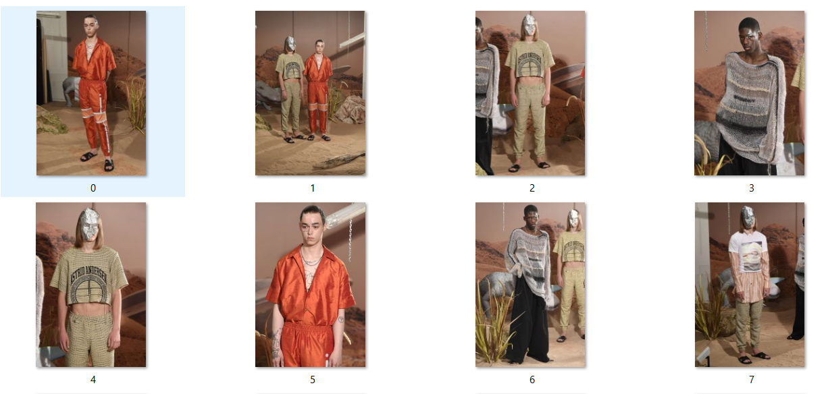
Name of the pictures + tag
2019_SS_Paris_Female_Isabel-Marrant(0)2a
2019_SS_Paris_Female_Isabel-Marrant(1)53b
2019_SS_Paris_Female_Isabel-Marrant(2)34v
2019_SS_Paris_Female_Isabel-Marrant(3)31c
2019_SS_Paris_Female_Isabel-Marrant(4)81g
……….
Tag of the picture
Name of the picture
_2a
L2 tag
Season
City
Gender
Brand’s name
Picture’s number

